Slide 1

WELCOME

Slide 2
Case Study of Bulk Email Sender Tracker

Slide 3
Some of the use cases of Bulk User Sender Tracker Automation
Mailing count
Sender ‘s info
Threshold Limit
Hourly basis
Real Time Monitoring
Database Management
Avoiding Server Clogging

Slide 4
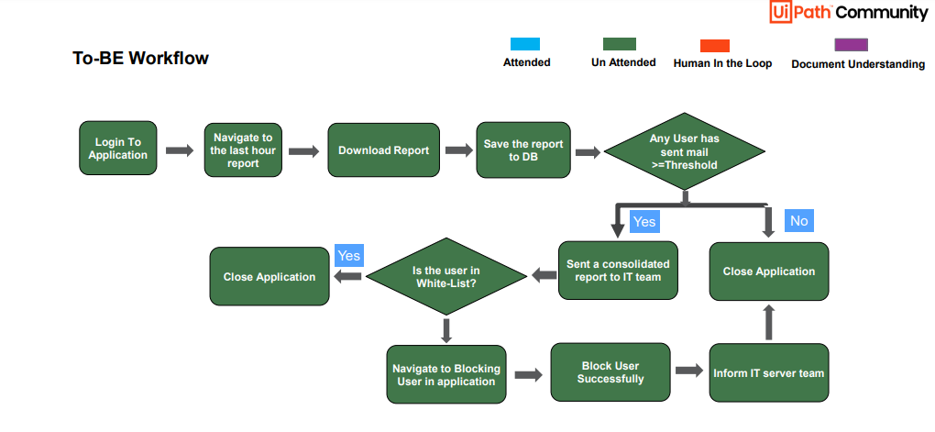
AS-IS & TO-BE workflow

Slide 5
One Case Study – Bulk User Sender Tracker
Challenges:
One of the Leading Company unable to track the emails sent out by the users in real time, till server outage occurs as it takes a lot of time for them and need 3 FTE to track number of mails sent out by users.
Solution:
IT Server team check the count of mails sent by users per day and also set the threshold limit per user per day. If any user cross the threshold limit IT Server team goes to the system to block the user mail I’d from sending any more mail’s.

Slide 6
Conclusion
The tasks involved in Bulk User Sender Tracker should be Automate by RPA by using different tools like UIPATH ,Blue Prism, Automation anywhere…etc

Slide 7
Other Information about use case
Industry Categories for this use case: Compliance ,Information Technology, Operations & Telecom.
Skill Level Required : Intermediate.
UI Path Products that were used: UI Path Studio, UI Path APPS, UI Path Orchestrator.
Other Applications that were used: SQL, Email Server Management tool.

Slide 8
THANK YOU

